Slide 1



Maven Analytics Challenge Mexico Restaurants
View in Power BI
Last data refresh:
11/6/2021 2:38:37 PM UTC
Downloaded at:
12/24/2021 6:10:36 PM UTC

Slide 2
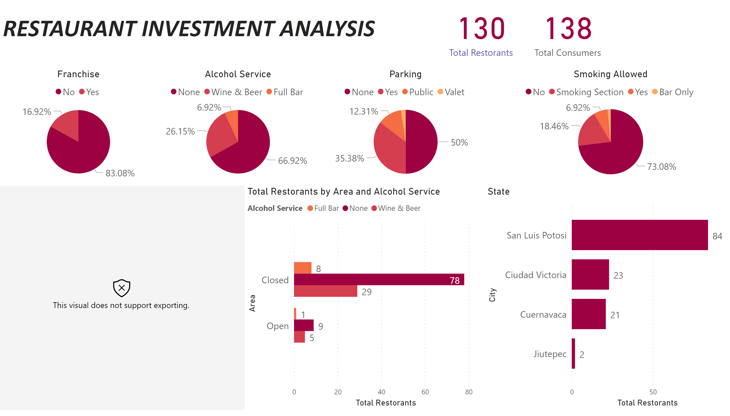
Restaurant Investment Analysis
Notes:
Franchise
No alt text provided
Parking
No alt text provided
Smoking Allowed
No alt text provided
Alcohol Service
No alt text provided
hierarchy50DB3783432B40A69C0B91926CE74CD9
No alt text provided
State
No alt text provided
textbox
No alt text provided
card
No alt text provided
clusteredBarChart
No alt text provided
card
No alt text provided

Slide 3
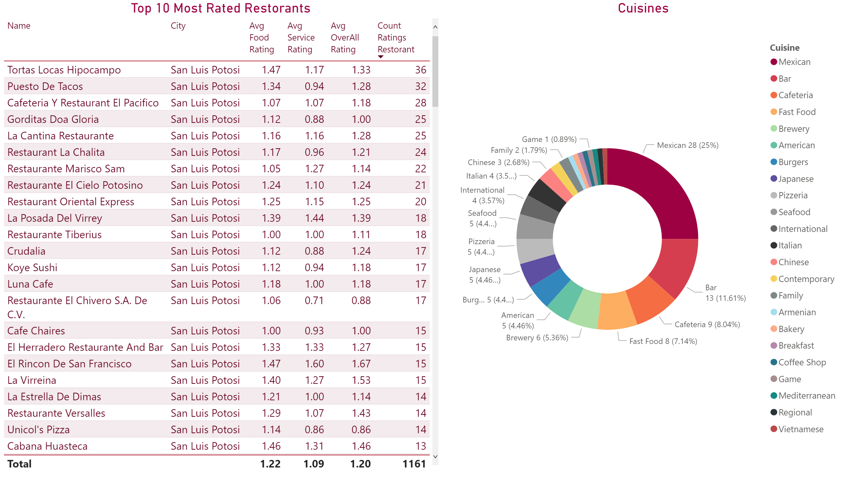
Ratings & Cuisines
Notes:
Top 10 Most Rated Restorants
No alt text provided
Cuisines
No alt text provided

